Slide 1
An Update from the NYSED Offices of Curriculum & Instruction, and Assessment
NYSAMS Leadership Summit
September 2014
Sue Brockley, Mathematics Assistant
EngageNY.org

Slide 2
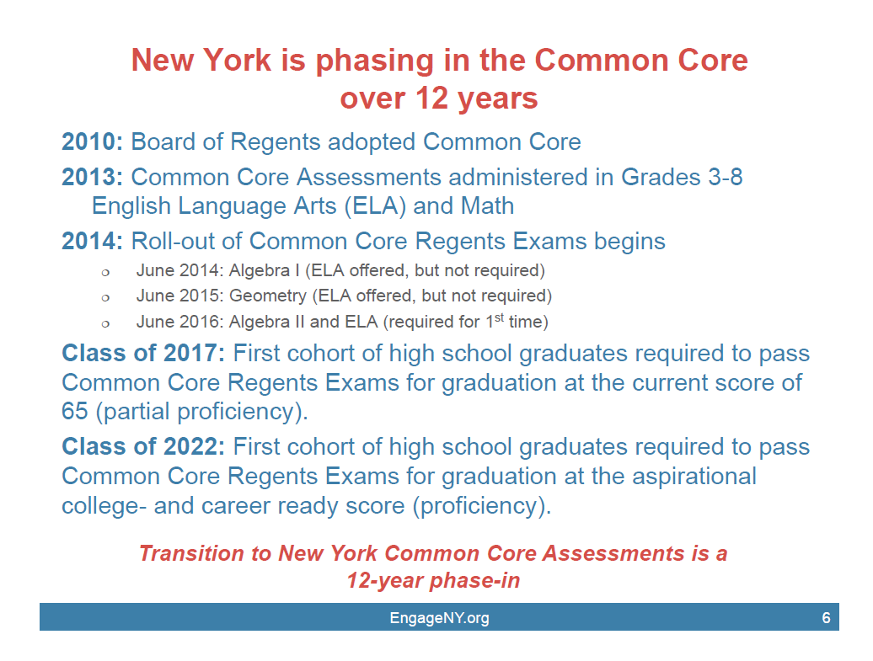

Slide 3
What’s New…
Resources
RFP
Pre-K Modules
Engage
Common Core Assessments Page
Algebra II
Geometry
Acceleration
Geo Test Blueprint
Graduation Pathways
Thank You
EngageNY.org

Slide 4
How has constructing a sound answer changed with the
Common Core ?
Rigor
Procedural
Conceptual
Compute
Solve
Identify
Mathematical Practice #3
Construct viable arguments and critique the reasoning of others.
Explain/Justify
Describe how/why . . .
Make clear and/or offer reason.
Convey an idea, qualities or background information.
Students will provide/use solid mathematical arguments and language.
Written paragraph.
Measurement using appropriate tools.
Written proof.
Rigid Motion
EngageNY.org

Slide 5



Geometry
SRT
C
GMD
CO
MG
GPE
BACK
EngageNY.org

Slide 6
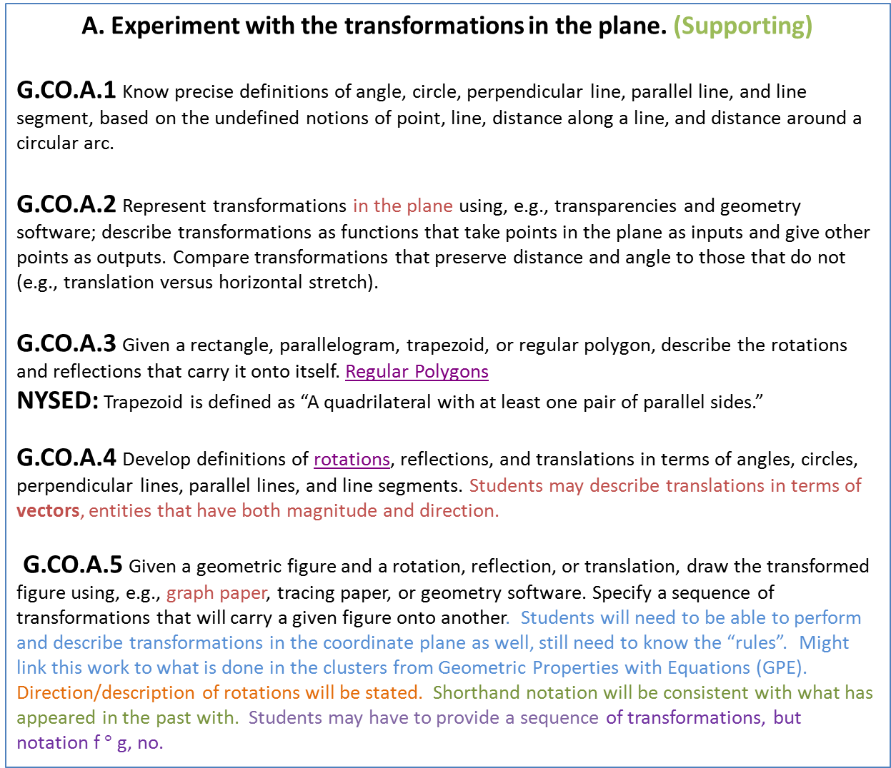
Congruence (G-CO)
A. Experiment with the transformations in the plane. (Supporting)
G.CO.A.1 Know precise definitions of angle, circle, perpendicular line, parallel line, and line segment, based on the undefined notions of point, line, distance along a line, and distance around a circular arc.
G.CO.A.2 Represent transformations in the plane using, e.g., transparencies and geometry software; describe transformations as functions that take points in the plane as inputs and give other points as outputs. Compare transformations that preserve distance and angle to those that do not (e.g., translation versus horizontal stretch).
G.CO.A.3 Given a rectangle, parallelogram, trapezoid, or regular polygon, describe the rotations and reflections that carry it onto itself. Regular Polygons
NYSED: Trapezoid is defined as “A quadrilateral with at least one pair of parallel sides.”
G.CO.A.4 Develop definitions of rotations, reflections, and translations in terms of angles, circles, perpendicular lines, parallel lines, and line segments. Students may describe translations in terms of vectors, entities that have both magnitude and direction.
G.CO.A.5 Given a geometric figure and a rotation, reflection, or translation, draw the transformed figure using, e.g., graph paper, tracing paper, or geometry software. Specify a sequence of transformations that will carry a given figure onto another. Students will need to be able to perform and describe transformations in the coordinate plane as well, still need to know the “rules”. Might link this work to what is done in the clusters from Geometric Properties with Equations (GPE). Direction/description of rotations will be stated. Shorthand notation will be consistent with what has appeared in the past with. Students may have to provide a sequence of transformations, but notation f $°$ g, no.

Slide 7

Congruence (G-CO)
B. Understand congruence in terms of rigid motions. (Major)
G.CO.B.6 Use geometric descriptions of rigid motions to transform figures and to predict the effect of a given rigid motion on a given figure; given two figures, use the definition of congruence in terms of rigid motions to decide if they are congruent. A rigid motion of the plane ( also known as an isometry ) is a motion which preserves distance and angle measure.
There are four basic rigid motions:
(1) Reflection
(2) Glide Reflection
(3) Rotation
(4) Translation
What do they do….
Map lines to lines, rays to rays, segments to segments, angles to angles
Preserve lengths of segments and the measures of angles
G.CO.B.7 Use the definition of congruence in terms of rigid motions to show that two triangles are congruent if and only if corresponding pairs of sides and corresponding pairs of angles are congruent. Illustrative Math
G.CO.B.8 Explain how the criteria for triangle congruence (ASA, SAS, and SSS) follow from the definition of congruence in terms of rigid motions.

Slide 8
To start reasoning about the congruence of the two triangles, Sue and Peter have created the following diagram in which they have marked an ASA relationship between the triangles.
Based on the diagram, which angles have Peter and Sue indicated are congruent? Which sides?
2. To convince themselves that the two triangles are congruent, what else would Peter and Sue need to know?
S
B
T
C
A
R
“I know what to do,” said Peter. “We can translate point A until it maps with point R, then rotate line segment AB about point R until it maps with
Line segment RS. Finally, we can reflect ΔABC across line segment RS and then
everything maps so the triangles are congruent.” Sue says…”Hmmmm…”
C
B
S
Is this enough language, is the argument complete ?
T
Adapted from 2012 Mathematics Vision Project mathematicsvisionproject.org
A
R

Slide 9
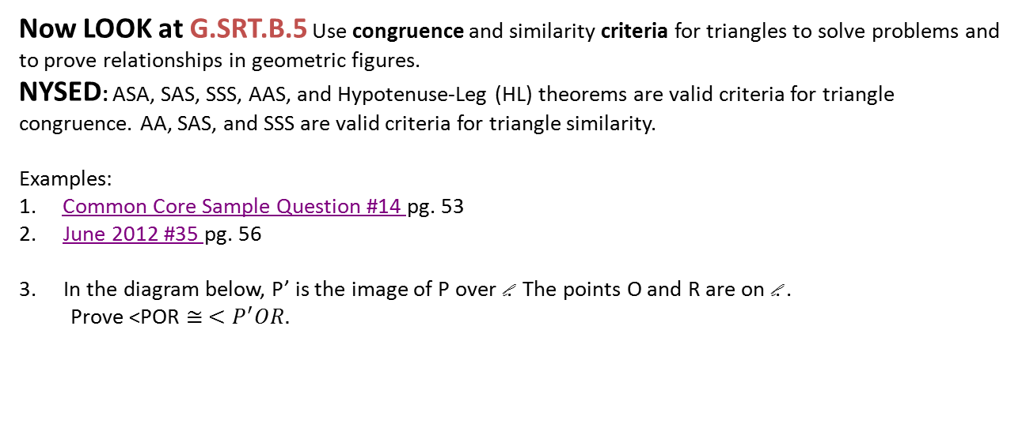
Now LOOK at G.SRT.B.5 Use congruence and similarity criteria for triangles to solve problems and to prove relationships in geometric figures.
NYSED: ASA, SAS, SSS, AAS, and Hypotenuse‐Leg (HL) theorems are valid criteria for triangle congruence. AA, SAS, and SSS are valid criteria for triangle similarity.
Examples:
1. Common Core Sample Question #14 pg. 53
June 2012 #35 pg. 56
In the diagram below, P’ is the image of P over l. The points O and R are on l. .
Prove <POR $≅ <P^{′}OR.$
P
l
O
R
Language of Transformations
P’
Reflections: A point P’ is the reflected image of point P over line l iff l is the perpendicular bisector of segment PP’, assuming points P and P’ are not on l

Slide 10
Congruence (G-CO)
C. Prove geometric theorems. (Major)
G.CO.C.9 Prove theorems about lines and angles. Theorems include: vertical angles are congruent; when a transversal crosses parallel lines, alternate interior angles are congruent and corresponding angles are congruent; points on a perpendicular bisector of a line segment are exactly those equidistant from the segment’s endpoints.
NYSED: Theorems include but are not limited to the listed theorems. Example: theorems that involve complementary or supplementary angles.
G.CO.C.10 Prove theorems about triangles. Theorems include: measures of interior angles of a triangle sum to 180°; base angles of isosceles triangles are congruent; the segment joining midpoints of two sides of a triangle is parallel to the third side and half the length; the medians of a triangle meet at a point.
NYSED: Theorems include but are not limited to the listed theorems.
Example: an exterior angle of a triangle is equal to the sum of the two non‐adjacent interior angles of the triangle.
G.CO.C.11 Prove theorems about parallelograms (trapezoids). Theorems include: opposite sides are congruent, opposite angles are congruent, the diagonals of a parallelogram bisect each other, and conversely, rectangles are parallelograms with congruent diagonals.
NYSED: Theorems include but are not limited to the listed theorems.
Example: rhombus is a parallelogram with perpendicular diagonals.
These theorems need not be grand theorems, but rather any non-obvious statement that can be justified on the basis of previously established statements. Proof by contradiction, valid method of proof.
Algebraic problems using theorems- link to G.SRT.B.5: Use congruence and similarity criteria for triangles to solve problems and to prove relationships in geometric figures.

Slide 11
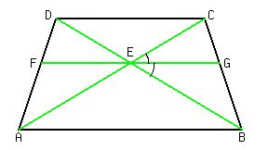
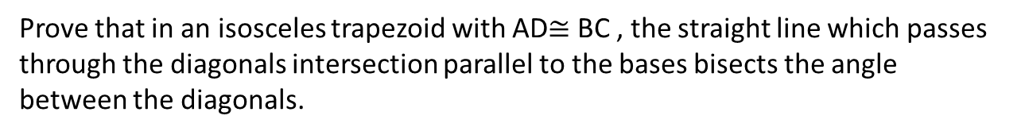
Use transformational geometry to prove simple angle theorems…
The congruence of vertical angles (rotations)
If two parallel lines are cut by a transversal, then the corresponding angles are congruent. (translations)
The sum of the angles of a triangle is 180.
C
C’
3
1
2
4
5
A
B
B’
Prove that in an isosceles trapezoid with AD$≅$ BC , the straight line which passes through the diagonals intersection parallel to the bases bisects the angle between the diagonals.

Slide 12
Congruence (G-CO)
D. Make geometric constructions. (Supporting)
G.CO.D.12 Make formal geometric constructions with a variety of tools and methods (compass and straightedge, string, reflective devices, paper folding, dynamic geometric software, etc.). Copying a segment; copying an angle; bisecting a segment; bisecting an angle; constructing perpendicular lines, including the perpendicular bisector of a line segment; and constructing a line parallel to a given line through a point not on the line.
NYSED: Constructions include but are not limited to the listed constructions.
Example: constructing the median of a triangle or constructing an isosceles triangle with given lengths.
All constructions from 2005 are fair game….
Link to G.C.A.3 Construct the inscribed and circumscribed circles of a triangle.
G.CO.D.13 Construct an equilateral triangle, a square, and a regular hexagon inscribed in a circle.
Square Equilateral triangle Might want to link with standards in the Circles clusters.
Back to Tree

Slide 13
Similarity, Right Triangles and Trigonometry (G-SRT)
Understand similarity in terms of similarity transformations. (Major)
G.SRT.A.1 Verify experimentally the properties of dilations given by a center and a scale factor.
a. A dilation takes a line not passing through the center of the dilation to a parallel line, and
leaves a line passing through the center unchanged.
b. The dilation of a line segment is longer or shorter in the ratio given by the scale factor.
Performing dilations in the coordinate plane is within the scope of this standard. The center does not always need to be the origin. Assessment items will always be clear as to the center of the dilation.
G.SRT.A.2 Given two figures, use the definition of similarity in terms of similarity transformations to decide if they are similar; explain using similarity transformations the meaning of similarity for triangles as the equality of all corresponding pairs of angles and the proportionality of all corresponding pairs of sides.
G.SRT.A.3 Use the properties of similarity transformations to establish the AA criterion for two triangles to be similar. Students will be proving why the AA similarity criteria works. SSS and SAS similarity criteria as well.
G.SRT.B.5 Use congruence and similarity criteria for triangles to solve problems and to prove relationships in geometric figures.
NYSED: ASA, SAS, SSS, AAS, and Hypotenuse‐Leg (HL) theorems are valid criteria for triangle congruence. AA, SAS, and SSS are valid criteria for triangle similarity.

Slide 14
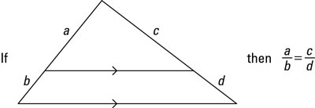
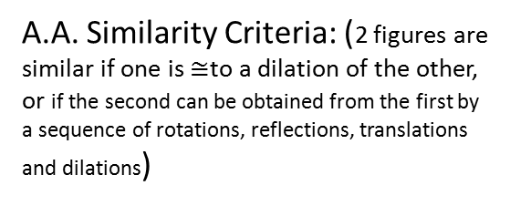
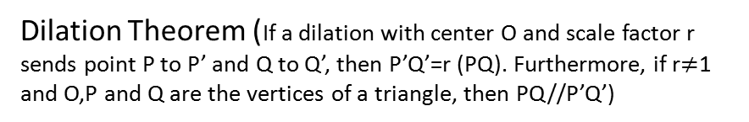
The Progression of the Similarity …
Scale Drawings : Ratio and Parallel Method
Triangle Splitter Theorem or Triangle Proportionality Theorem (A line segment splits two sides of a triangle proportionally iff it is parallel to the third side. )
Dilation Theorem (If a dilation with center O and scale factor r sends point P to P’ and Q to Q’, then P’Q’=r (PQ). Furthermore, if r$≠$1 and O,P and Q are the vertices of a triangle, then PQ//P’Q’)
A.A. Similarity Criteria: (2 figures are similar if one is $≅$to a dilation of the other, or if the second can be obtained from the first by a sequence of rotations, reflections, translations and dilations)
S.A.S and SSS Similarity Criteria

Slide 15
Similarity, Right Triangles and Trigonometry (G-SRT)
B. Prove theorems using similarity. (Major)
G.SRT.B.4 Prove theorems about triangles. Theorems include: a line parallel to one side of a triangle divides the other two proportionally, and conversely; the Pythagorean Theorem proved using triangle similarity.
NYSED: Theorems include but are not limited to the listed theorems.
Example: the length of the altitude drawn from the vertex of the right angle of a right triangle to its hypotenuse is the geometric mean between the lengths of the two segments of the hypotenuse.
G.SRT.B.5 Use congruence and similarity criteria for triangles to solve problems and to prove relationships in geometric figures. Algebraic problems using theorems.
NYSED: ASA, SAS, SSS, AAS, and Hypotenuse‐Leg (HL) theorems are valid criteria for triangle congruence. AA, SAS, and SSS are valid criteria for triangle similarity.
C. Define trigonometric ratios and solve problems involving right triangles. (Major)
G.SRT.C.6 Understand that by similarity, side ratios in right triangles are properties of the angles in the triangle, leading to definitions of trigonometric ratios for acute angles.
G.SRT.C.7 Explain and use the relationship between the sine and cosine of complementary angles.
G.SRT.C.8 Use trigonometric ratios and the Pythagorean Theorem to solve right triangles in applied problems. Students will also have to find angles using inverse trig ratios.
Back to tree

Slide 16
Circles(G-C)
Understand and apply theorems about circles. (Supporting)
G.C.A.1 Prove that all circles are similar.
G.C.A.2 Identify and describe relationships among inscribed angles, radii, and chords. Include the relationship between central, inscribed, and circumscribed angles; inscribed angles on a diameter are right angles; the radius of a circle is perpendicular to the tangent where the radius intersects the circle.
NYSED: Relationships include but are not limited to the listed relationships.
Example: angles involving tangents and secants. (All 2005 circle theorems)
Find the equation of tangent lines, link to G.GPE.5.
G.C.A.3 Construct the inscribed and circumscribed circles of a triangle, and prove properties of angles for a quadrilateral inscribed in a circle.
B. Find arc lengths and areas of sectors of circles. (Supporting)
G.C.B.5 Derive using similarity the fact that the length of the arc intercepted by an angle is proportional to the radius, and define the radian measure of the angle as the constant of proportionality; derive the formula for the area of a sector.

Slide 17
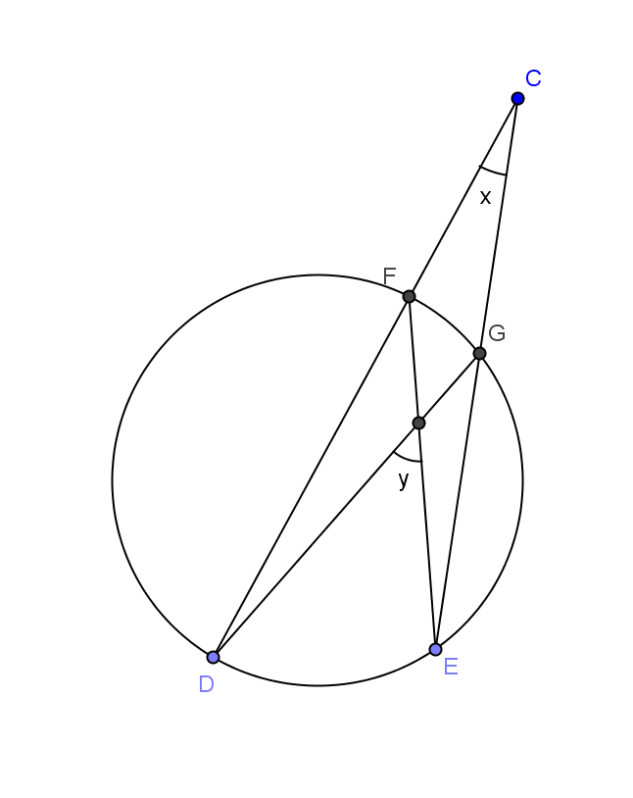
Use the diagram to show that measure of arc DE=y+x and the measure of arc FG=y-x and show your work.
What about circle proofs ? Link to G. SRT.5
Common Core Sample Question #13
In the diagram below, secant ACD and tangent AB are drawn from external point A
to circle O.
Prove the theorem: If a secant and a tangent are drawn to a circle from an external
point, the product of the lengths of the secant segment and its
external segment equals the length of the tangent segment
squared. (AC x AD = AB^2 )
A
B
C
.
O
Back to Tree
D

Slide 18
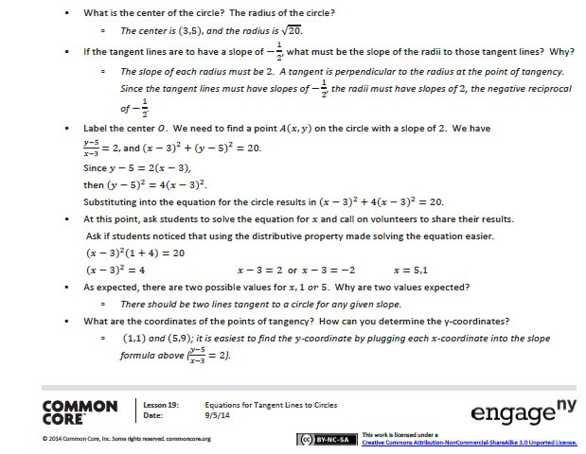
Consider the circle with equation ${(x−3)}^{2}$ + ${(y−5)}^{2}$ = 20. Find the equations of two tangent lines to the circle that each have slope -1/2.
y-9= -1/2(x-5)
y-1= -1/2(x-1)
Back

Slide 19
Expressing Geometric Properties with Equations (G-GPE)
Translate between the geometric description and the equation of a conic section.
(Supporting)
G.GPE.A.1 Derive the equation of a circle of given center and radius using the Pythagorean Theorem; complete the square to find the center and radius of a circle given by an equation.
Equations will not be seen in center/radius form as in the past. Students will still need to transfer back and forth between equation and graph. Example
B. Use coordinates to prove simple geometric theorems algebraically. (Major)
G.GPE.B.4 Use coordinates to prove simple geometric theorems algebraically. For example, prove or disprove that a figure defined by four given points in the coordinate plane is a rectangle; prove or disprove that the point (1, √3) lies on the circle centered at the origin and containing the point (0, 2). This involves students using the midpoint, slope and distance formulas.
G.GPE.B.5 Prove the slope criteria for parallel and perpendicular lines and use them to solve geometric problems (e.g., find the equation of a line parallel or perpendicular to a given line that passes through a given point). Methods
G.GPE.B.6 Find the point on a directed line segment between two given points that partitions the segment in a given ratio.
G.GPE.B.7 Use coordinates to compute perimeters of polygons and areas of triangles and rectangles, e.g., using the distance formula.
TREE

Slide 20
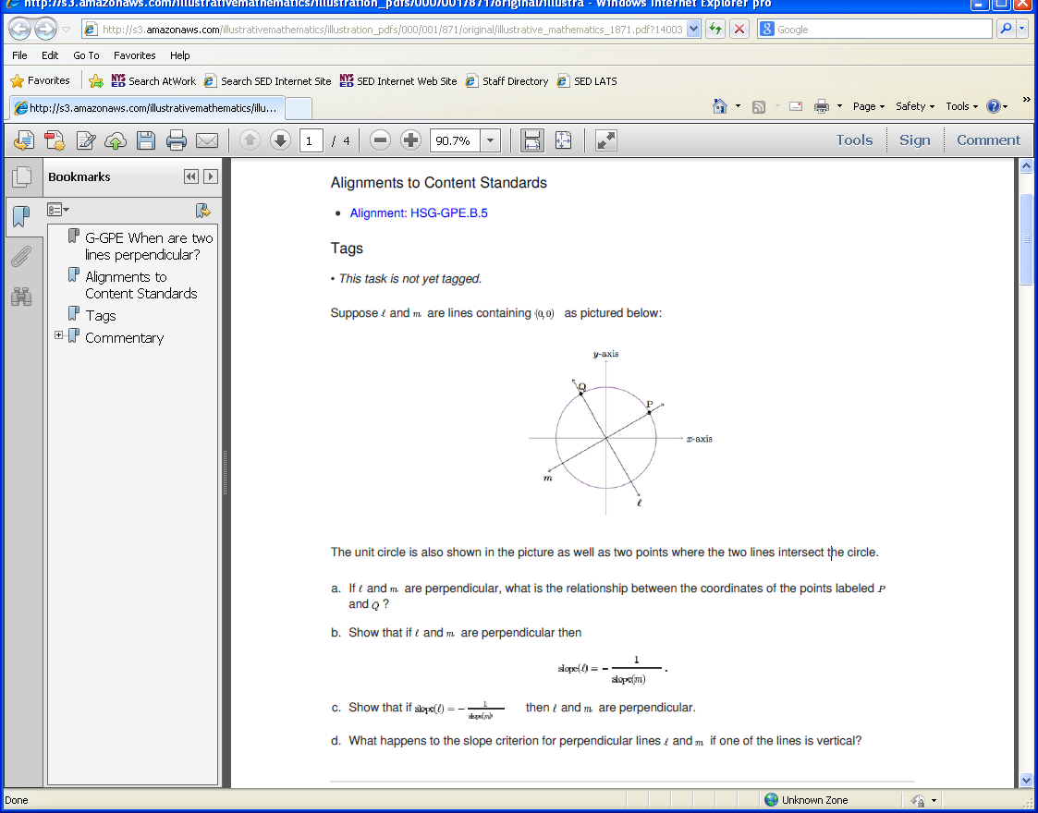
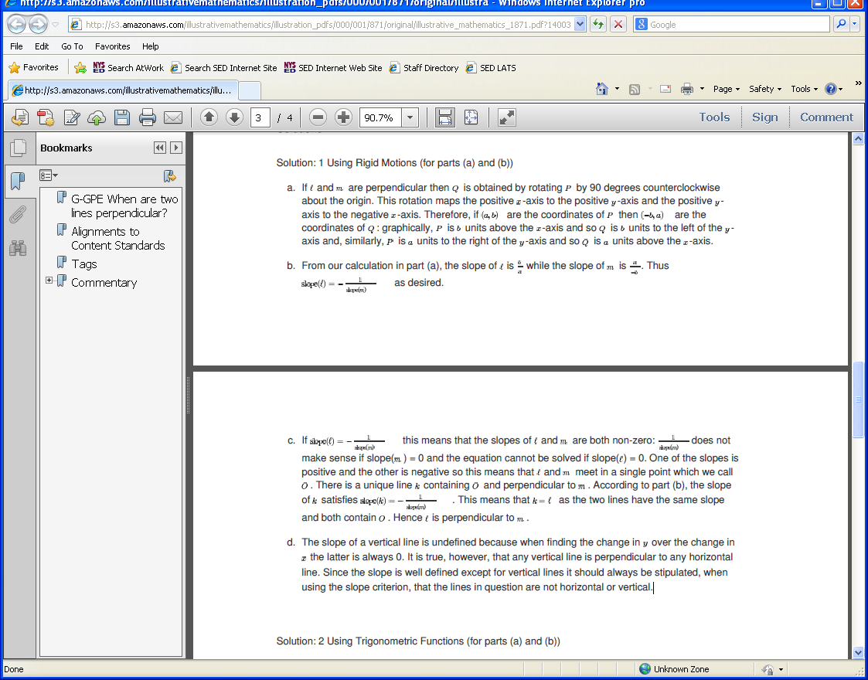
Method One: Illustrative Math: When are two lines perpendicular ?

Slide 21
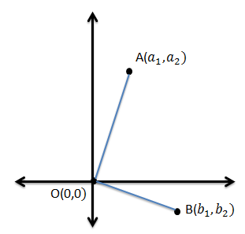





Method Two: Module 4 Connecting Algebra and Geometry Through Coordinates
Topic B Lessons 5-8
Lesson 5: Using the Pythagorean Theorem
OA=$\sqrt{{a1}^{2}+{a2}^{2}}$
OB=$\sqrt{{b1}^{2}+{b2}^{2}}$
If OA is perpendicular to OB then (and common endpoint at origin) …
AB=$\sqrt{{(b1−a1)}^{2}+{(b2−a2)}^{2}}$
$${OA}^{2}+{OB}^{2}={AB}^{2}$$
0=($a_{1})(b_{1})+(a_{2})(b_{2})$
Slopes are opposite reciprocals

Slide 22
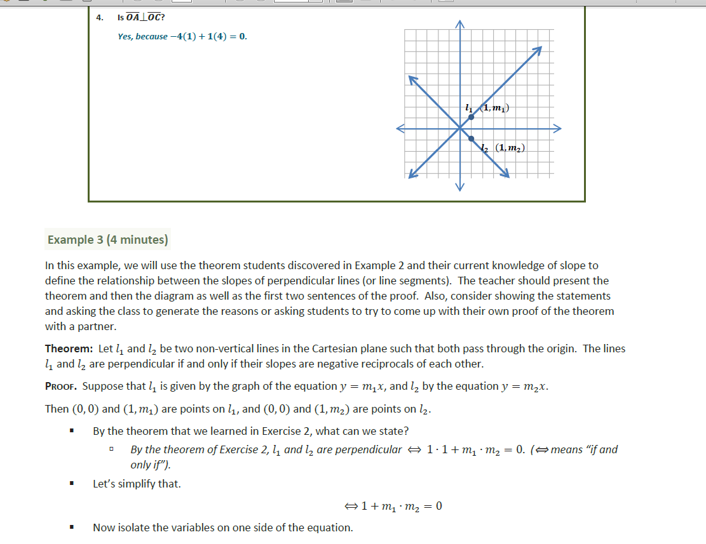

Slide 23
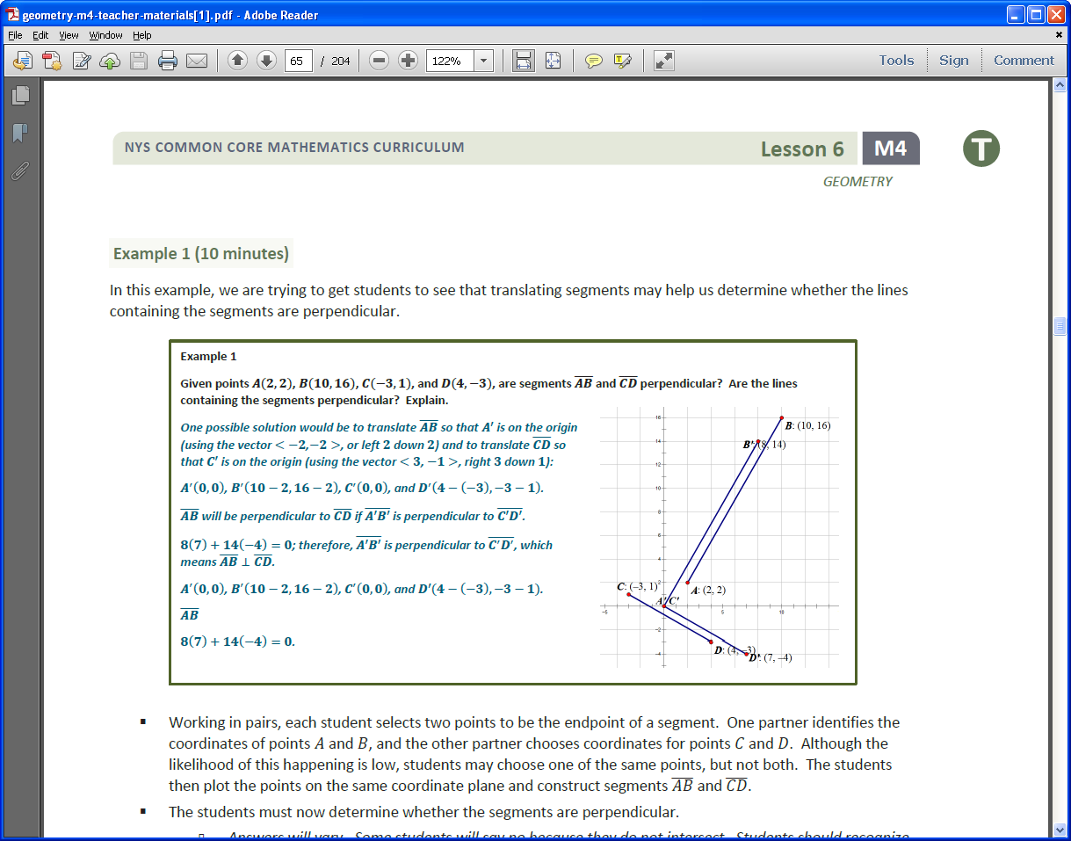

Slide 24
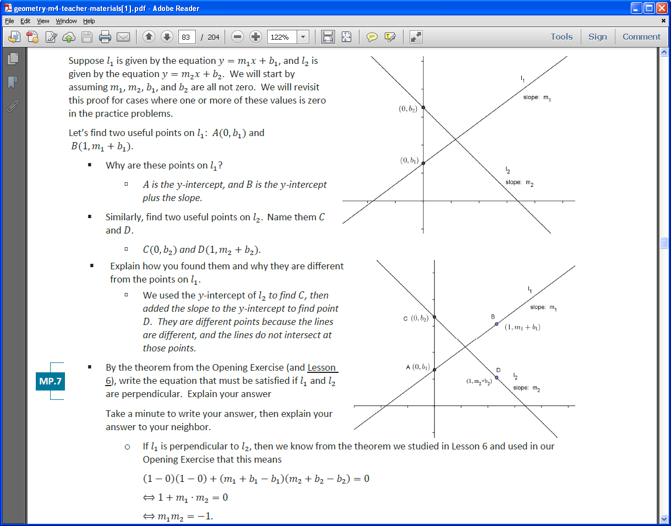
Lesson 8

Slide 25
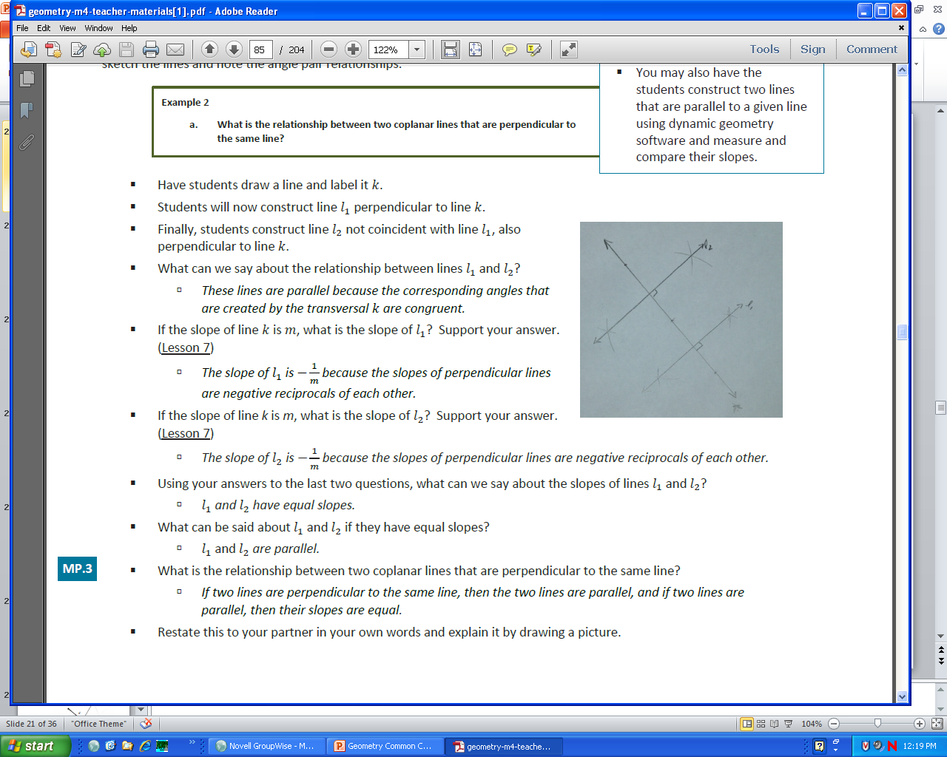
Back

Slide 26
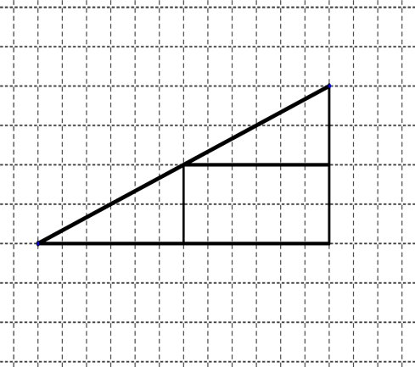





${(x}_{2}$,$y_{2}$)
Derivation of the midpoint formula
${(x}_{m}$,$y_{m}$)
${(x}_{1}$,$y_{1}$)
$x_{m}$ - $x_{1 }$= ½ ($x_{2}$-$x_{1}$)
$y_{m}$ - $y_{1 }$= ½ ($y_{2}$-$y_{1}$)

Slide 27
Given the points A(-1,2) and B(7, 8), find the
coordinates of point P on directed line segment
AB that partitions AB in the ratio 1/3.
B(7, 8)
8-2
1/4 of 6=1.5
A(-1,2)
X- -1 = ¼ (7 - -1)
X+1=2
X=1
Y-2= ¼ (8-2)
Y-2=1.5
Y=3.5
7- -1
1/4 of 8=2
B(7, 8)
1.5
P(1,3.5)
A(-1,2)
2
BACK

Slide 28
Geometric Measurement and Dimension (G-GMD)
A. Explain volume formulas and use them to solve problems. (Supporting)
G.GMD.A.1 Give an informal argument for the formulas for the circumference of a circle, area of a circle, volume of a cylinder, pyramid, and cone. Use dissection arguments, Cavalieri’s principle, and informal limit arguments. Example Cavalieri
G.GMD.A.3 Use volume formulas for cylinders, pyramids, cones, and spheres to solve problems.
B. Visualize relationships between two-dimensional and three-dimensional objects.
(Supporting)
G.GMD.B.4 Identify the shapes of two-dimensional cross-sections of three-dimensional objects, and identify three-dimensional objects generated by rotations of two-dimensional objects. Example
Back to tree

Slide 29
Modeling with Geometry (G-MD)
Apply geometric concepts in modeling situations. (Major)
G.MG.A.1 Use geometric shapes, their measures, and their properties to describe objects (e.g., modeling a tree trunk or a human torso as a cylinder).
G.MG.A.2 Apply concepts of density based on area and volume in modeling situations (e.g., persons per square mile, BTUs per cubic foot).
G.MG.A.3 Apply geometric methods to solve design problems (e.g., designing an object or structure to satisfy physical constraints or minimize cost; working with typographic grid systems based on ratios).
Example
Fluencies:
Triangle congruence and similarity criteria.
Use of coordinates to establish geometric results.
Constructions
BACK

Slide 30

Find the angle of rotation that will carry the 12 sided regular polygon to itself.
Exploring Rotational Symmetry
How many sides does a regular polygon have that has an angle of rotation equal to 20 degrees. How many lines of symmetry will it have ?
If one of the angles of a regular polygon is 160 degrees, find the angle of rotation that will carry this polygon onto itself.
Classify quadrilaterals based on transformational properties
180 degree rotation
180 degree rotation
2 lines of symmetry
through midpoint of sides
180 degree rotation
2 lines of symmetry along diagonals
90 and 180 degree rotation
4 lines of symmetry
along diagonals and through midpoints of sides
Back
Adapted from 2012 Mathematics Vision Project mathematicsvisionproject.org

Slide 31
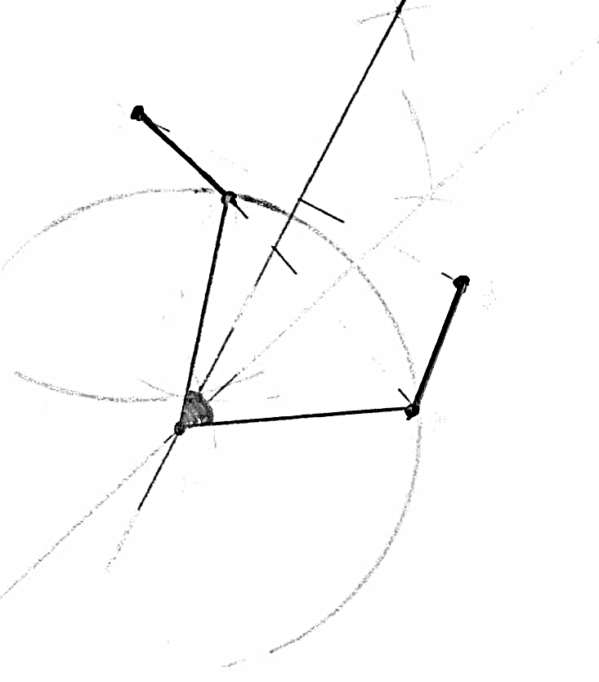
Find the center of the rotation that takes AB to A’B’.
B’
A’
B
A
Back

Slide 32
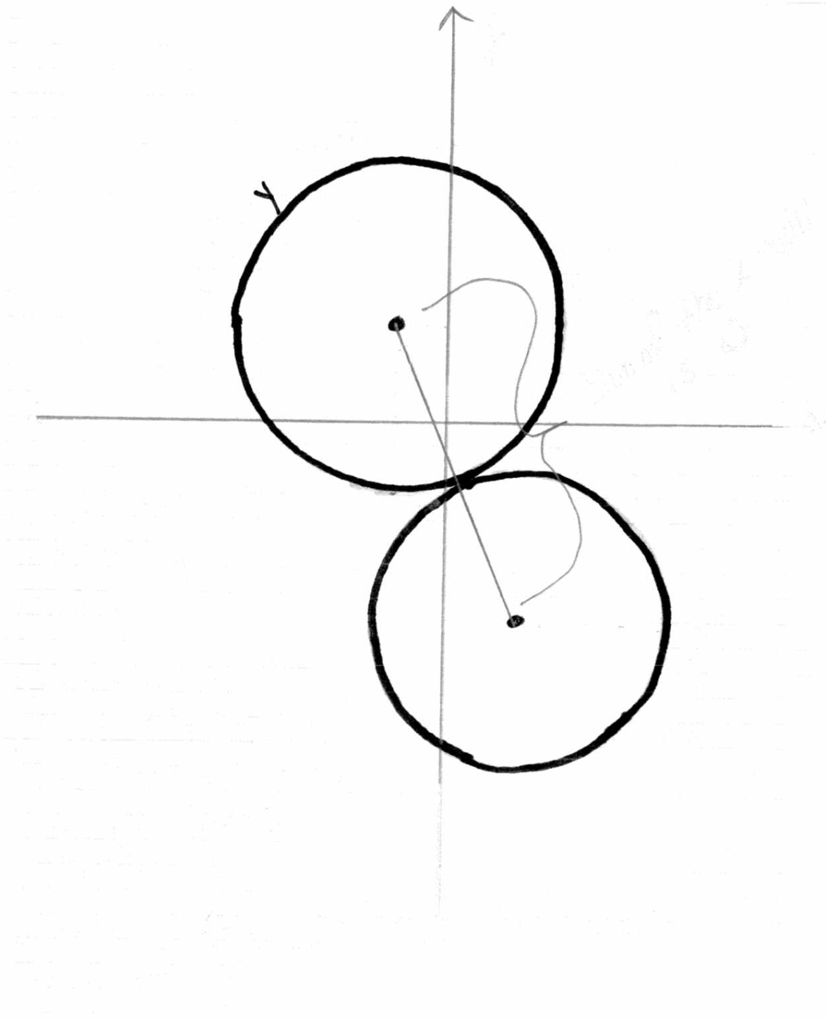
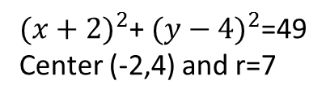
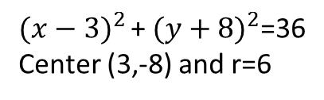


Chante claims that two circles given by ${(x+2)}^{2}$+ ${(y−4)}^{2}$=49 and $x^{2}$+$y^{2}$-6x+16y+37=0 are externally tangent. Justify why she is correct.
${(x+2)}^{2}$+ ${(y−4)}^{2}$=49
Center (-2,4) and r=7
Is the distance between the two radii equal to the sum of the radii ?
$x^{2}$+$y^{2}$-6x+16y+37=0
$x^{2}$-6x + $y^{2}$ - 16y = -37
${(x−3)}^{2 }$+ ${(y+8)}^{2}$=36
Center (3,-8) and r=6
BACK

Slide 33
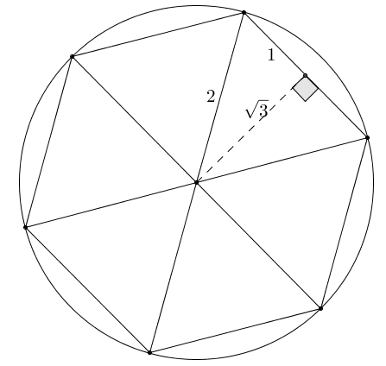
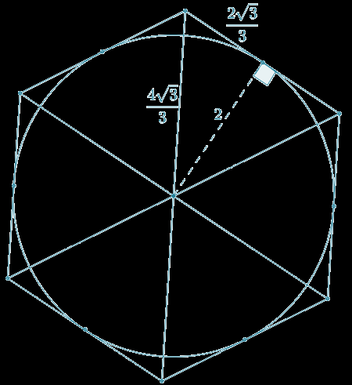
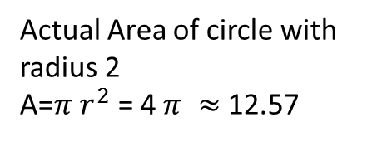
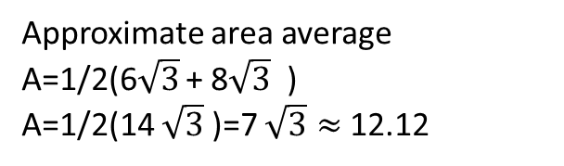
Informal Limit Arguments are used…
Area of Circle can be determined by taking the limit of the area of either inscribed regular polygons or circumscribed polygons as the number of sides n approaches infinity.
Approximate the area of a disk of radius 𝟐 using an inscribed regular
hexagon.
Approximate the area of a disk of radius 𝟐 using a circumscribed
regular hexagon.
Based on the areas of the inscribed and circumscribed hexagons, what is an approximate area of the given disk? What is the area of the disk by the area formula, and how does your approximation compare?
Approximate area average
A=1/2(6$\sqrt{3}$ + 8$\sqrt{3}$ )
A=1/2(14 $\sqrt{3}$ )=7 $\sqrt{3}≈$ 12.12
Actual Area of circle with radius 2
A=$π$ $r^{2}$ = 4 $π ≈$ 12.57

Slide 34
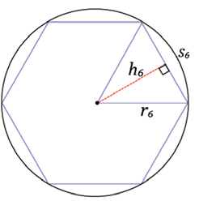
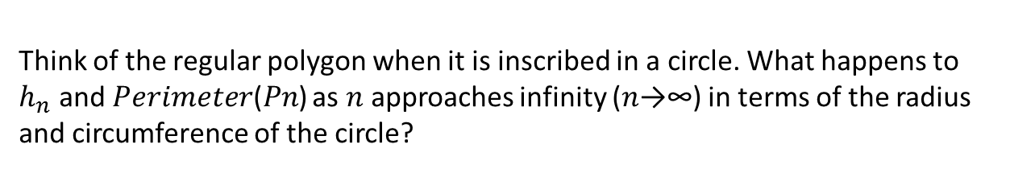
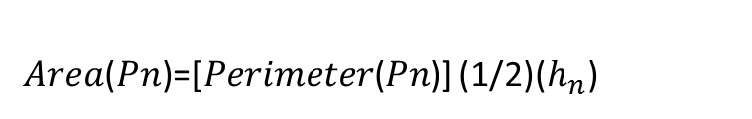
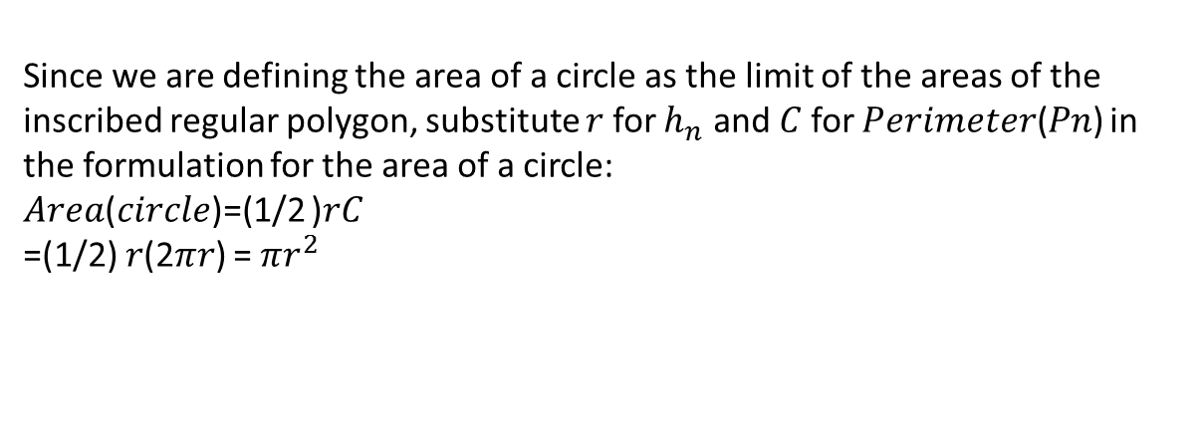
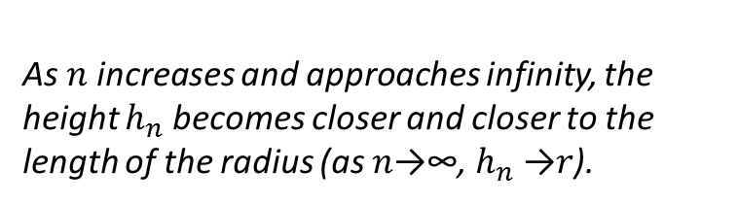
𝐴𝑟𝑒𝑎(𝑃𝑛)=[𝑃𝑒𝑟𝑖𝑚𝑒𝑡𝑒𝑟(𝑃𝑛)] (1/2)($h_{n}$)
Lesson 4 Module 2
Think of the regular polygon when it is inscribed in a circle. What happens to
$h_{n}$ and 𝑃𝑒𝑟𝑖𝑚𝑒𝑡𝑒𝑟(𝑃𝑛) as 𝑛 approaches infinity (𝑛→∞) in terms of the radius and circumference of the circle?
As 𝑛 increases and approaches infinity, the height $h_{n}$becomes closer and closer to the length of the radius (as 𝑛→∞, $h_{n}$→𝑟).
As 𝑛 increases and approaches infinity,
𝑃𝑒𝑟𝑖𝑚𝑒𝑡𝑒𝑟(𝑃𝑛) becomes closer and closer to the circumference of the circle
(as 𝑛→∞, 𝑃𝑒𝑟𝑖𝑚𝑒𝑡𝑒𝑟(𝑃𝑛)→𝐶)
Since we are defining the area of a circle as the limit of the areas of the inscribed regular polygon, substitute 𝑟 for $h_{n}$ and 𝐶 for 𝑃𝑒𝑟𝑖𝑚𝑒𝑡𝑒𝑟(𝑃𝑛) in the formulation for the area of a circle:
𝐴𝑟𝑒𝑎(𝑐𝑖𝑟𝑐𝑙𝑒)=(1/2 )𝑟𝐶
=(1/2) 𝑟(2𝜋𝑟) = 𝜋$r^{2}$

Slide 35
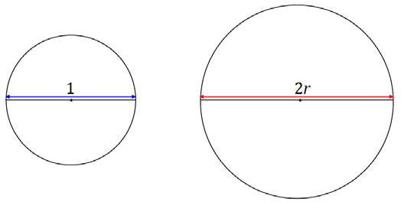
We are going to show why the circumference of a circle has the formula 𝟐𝝅𝒓. Circle 𝑪𝟏 below has a diameter of 𝒅=𝟏, and circle 𝑪𝟐 has a diameter of 𝒅=𝟐𝒓.
All circles are similar. What scale factor of the similarity transformation takes 𝑪𝟏 to 𝑪𝟐?
A scale factor of 𝟐𝒓.
Since the circumference of a circle is a one-dimensional measurement, the value of the ratio of two circumferences is equal to the value of the ratio of their respective diameters. Rewrite the following equation by filling in the appropriate values for the diameters of 𝑪𝟏 and 𝑪𝟐:
𝐂𝐢𝐫𝐜𝐮𝐦𝐟𝐞𝐫𝐞𝐧𝐜𝐞(𝑪𝟐)/𝐂𝐢𝐫𝐜𝐮𝐦𝐟𝐞𝐫𝐞𝐧𝐜𝐞(𝑪𝟏)=𝐝𝐢𝐚𝐦𝐞𝐭𝐞𝐫(𝑪𝟐)/𝐝𝐢𝐚𝐦𝐞𝐭𝐞𝐫(𝑪𝟏)
𝑪𝒊𝒓𝒄𝒖𝒎𝒇𝒆𝒓𝒆𝒏𝒄𝒆(𝑪𝟐)/𝑪𝒊𝒓𝒄𝒖𝒎𝒇𝒆𝒓𝒆𝒏𝒄𝒆(𝑪𝟏)=𝟐𝒓/𝟏
Since we have defined 𝝅 to be the circumference of a circle whose diameter is 𝟏, rewrite the above equation using this definition for 𝑪𝟏.
𝑪𝒊𝒓𝒄𝒖𝒎𝒇𝒆𝒓𝒆𝒏𝒄𝒆(𝑪𝟐)/𝝅=𝟐𝒓/𝟏
Rewrite the equation to show a formula for the circumference of 𝑪𝟐.
𝑪𝒊𝒓𝒄𝒖𝒎𝒇𝒆𝒓𝒆𝒏𝒄𝒆(𝑪𝟐)=𝟐𝝅𝒓
Back

Slide 36
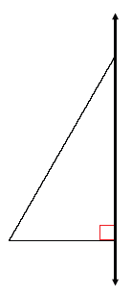
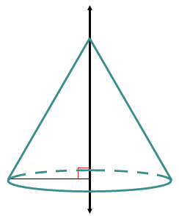
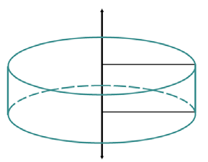
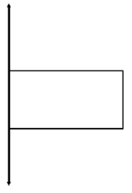

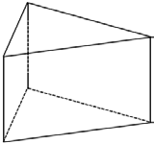
Sketch the figure formed if the rectangular (triangular) region is rotated around the provided axis:
Describe the shape of the cross-section of each of the following objects.
Right circular cone:
Cut by a plane through the vertex and perpendicular to the base
Triangular Prism :
Cut by a plane parallel to a base
Cut by a plane parallel to a face
Back

Slide 37
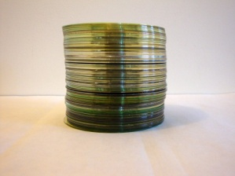
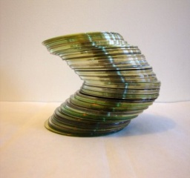
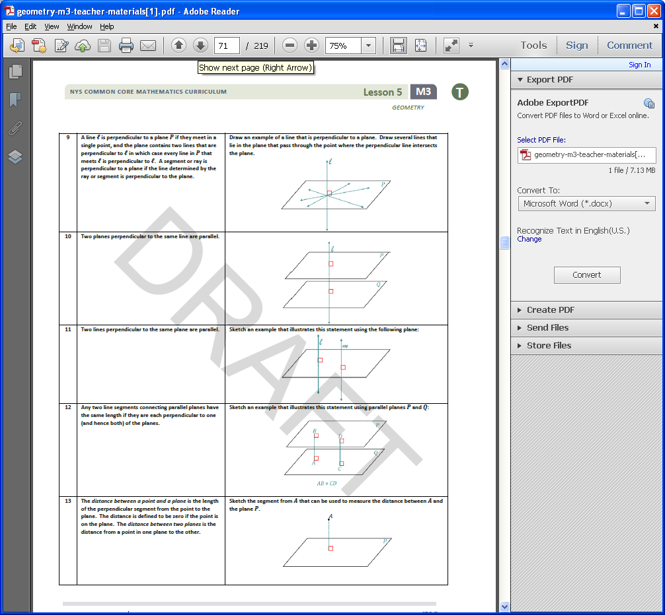
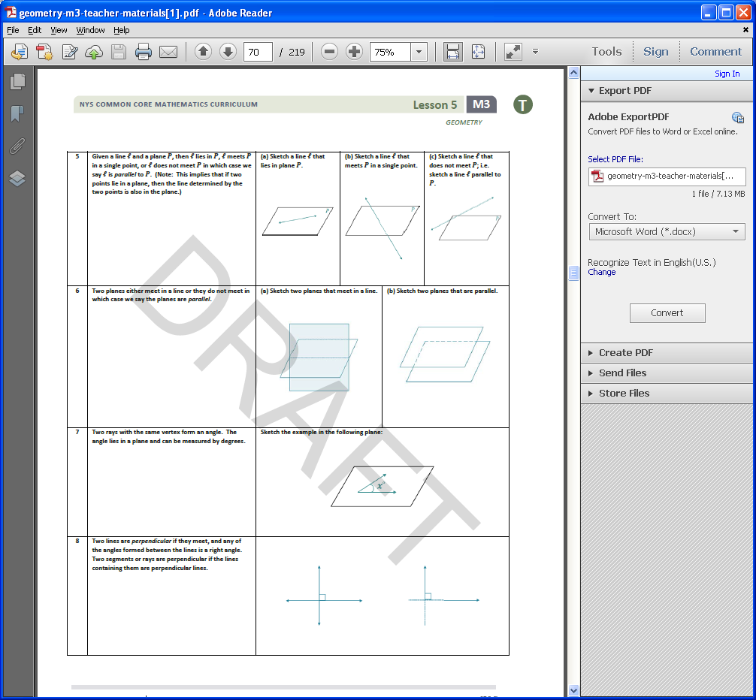
Cavalieri’s Principle: A method for finding the volume of any solid for which cross-sections by parallel planes have equal area.
Plane Properties Revisited

Slide 38
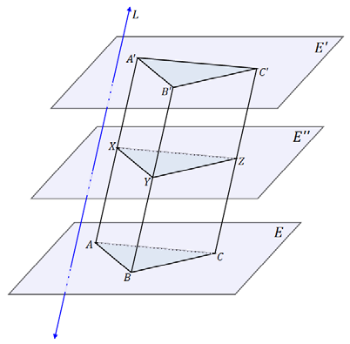
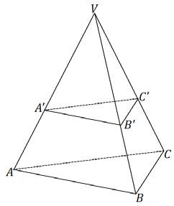
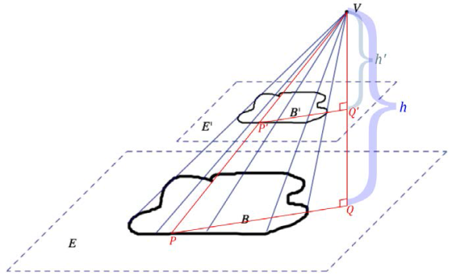
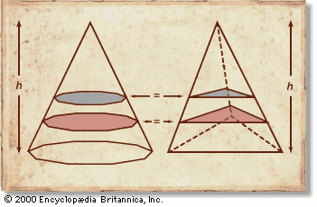
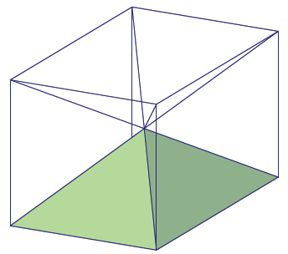
Using these plane properties/congruent triangles to informally prove Cavalieri’s Principle showing that for any prism, no matter what polygon the base is, the cross-sections are congruent to the base.
Prove that cross sections are similar to the base using dilations (lengths along edge of pyramid allows us to find scale factor of dilation) and SSS similarity criteria. The area of the similar region should be the area of the original figure times the square of the scale factor.
General Cone Cross-Section Theorem:
If two general cones have the same base area and the same height, then cross-sections for the general cones the same distance from the vertex have the same area.
Scaling and effect on volume
Cavalieri’s to prove volume of cylinder and cone
Informal argument and scaling used to prove volume of pyramid V=1/3(B)(h)
Back

Slide 39
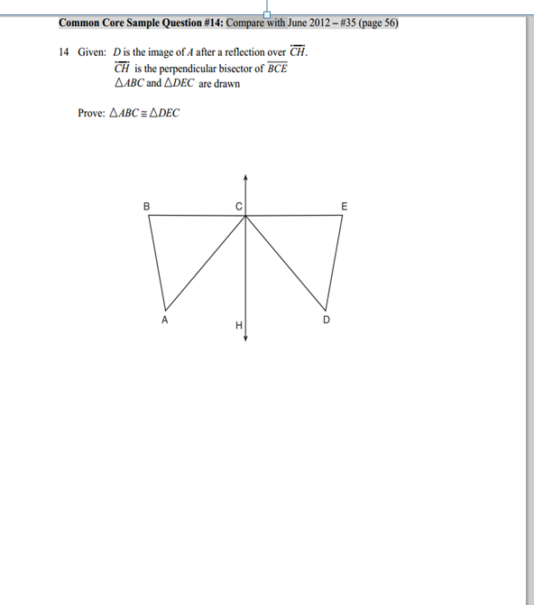
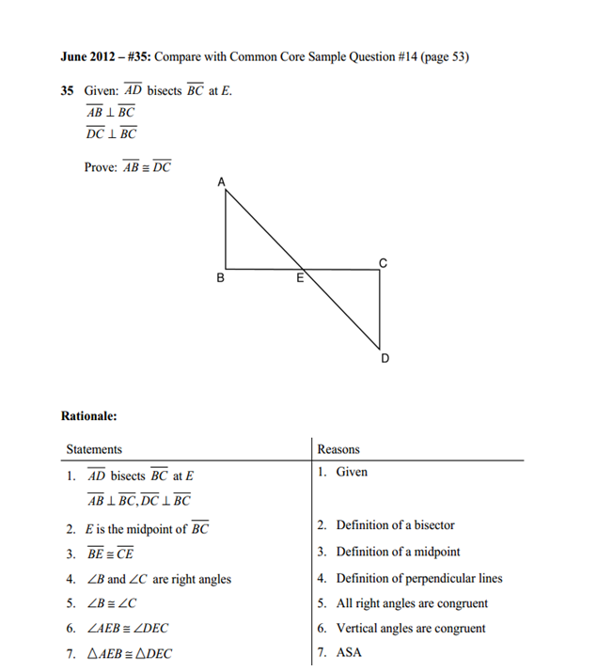
VS
Back

Slide 40
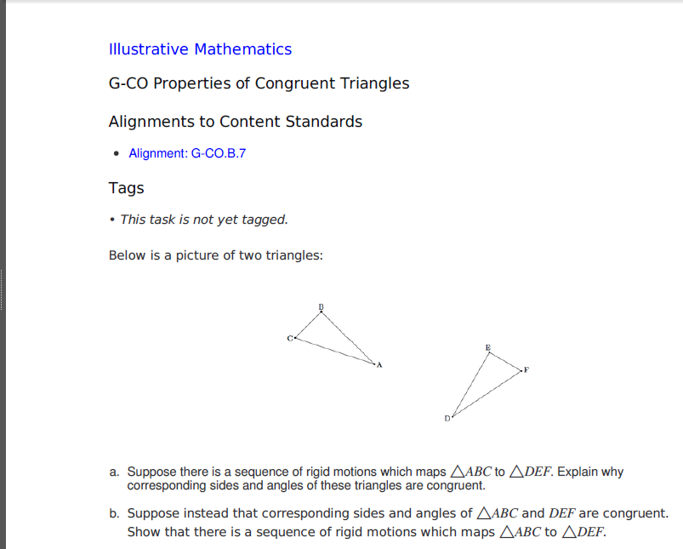
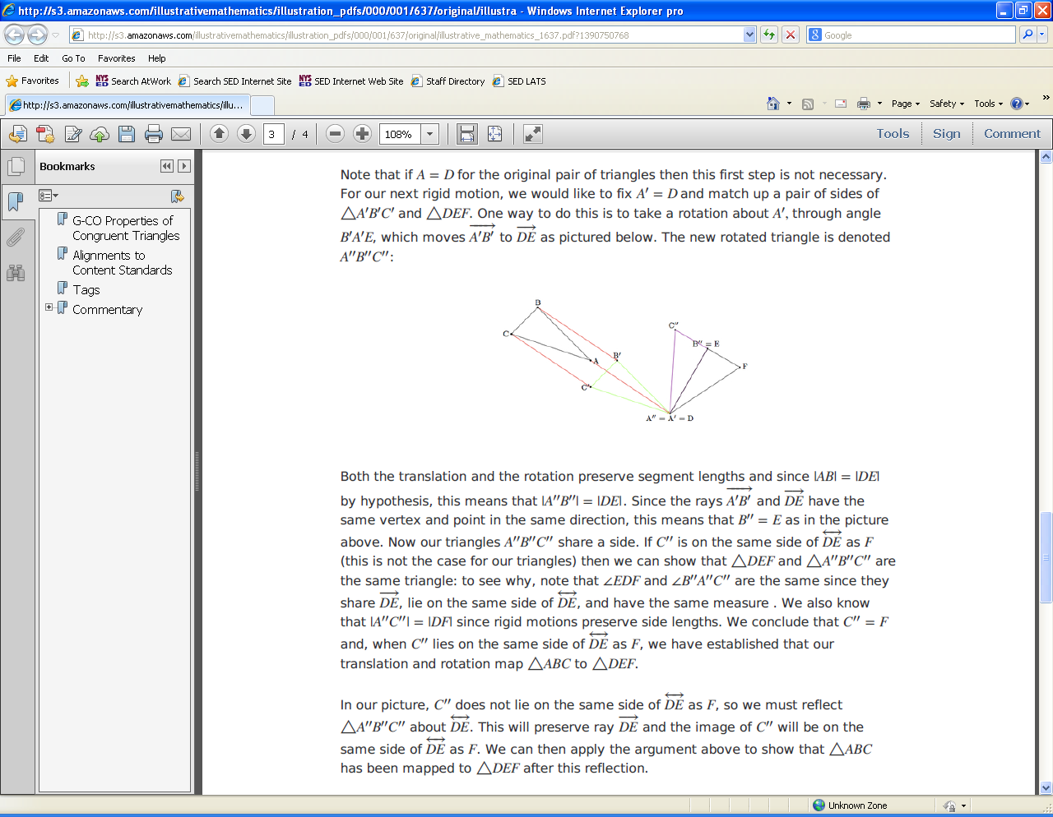
Back

Slide 41

BACK
BACK

Slide 42
Common Core Institute with Sponsored Common Core Institute Fellowship
The primary purpose of this request for proposals (RFP) is to grant school districts, Board of Cooperative Education Services (BOCES), and charter schools, from across the state, resources to allow the organization to serve as a Common Core Institute (CCI) and sponsor selected educators as Common Core Institute Fellows to support professional development and capacity-building, specifically through the enhancement of the optional and supplemental curricular modules currently posted on EngageNY.org.
Each eligible application must nominate one full-time educator or two part-time educators (each 50 percent of an FTE) for one of the grade levels in Grades K-12 Mathematics or Grades 3-12 ELA, or one full-time or two part-time ELL educators for two grades in an ELA grade band (3-4, 5-6, 7-8, 9-10, 11-12).
Applications must be received by: October 7, 2014
Anticipated Preliminary Award Notification: December 2014
Anticipated Project Period: January 2015 - June 30, 2015
CCINSTITUTE@mail.nysed.gov
http://usny.nysed.gov/rttt/rfp/sa-18/home.html
more precise and comprehensive scaffolds and supports for ELLs and SWDs
more effective formatting and usability
modular organization to support local pacing decisions
bridging supports for students who require remedial reinforcement
Additional performance tasks and DDI supports
BACK
EngageNY.org

Slide 43


BACK
EngageNY.org

Slide 44


50 % of 2014 3-8 test items released
On Engageny Home Page
News and Notes: Grades 3-8 Assessment Results
2014 Grades 3-8 ELA and Math Test Results
Information and Reporting Services (IRS)
Release of Data - August 14, 2014
Equating Explained FAQ
Educational Testing Service (ETS)
http://www.ets.org/Media/Research/pdf/RD_Connections16.pdf.
Raw Score/Percent Score/Scale Score/Equating Process/Anchor Items
EngageNY.org

Slide 45

Performance Level Definitions
NYS Level 5
Students performing at this level exceed Common Core expectations.
NYS Level 4
Students performing at this level meet Common Core expectations.
NYS Level 3
Students performing at this level partially meet Common Core expectations (required for current
Regents Diploma purposes).
NYS Level 2 (Safety Net)
Students performing at this level partially meet Common Core expectations (required for Local Diploma
purposes).
NYS Level 1
Students performing at this level do not demonstrate the knowledge and skills required for NYS Level 2.
… used in Assessment
PLDs are essential in setting standards for the New York State Regents Examinations. Standard setting
panelists use PLDs to determine the threshold expectations for students to demonstrate the knowledge
and skills necessary to attain just barely a Level 2, Level 3, Level 4, or Level 5 on the assessment. These
discussions then influence the panelists in establishing the cut scores on the assessment. PLDs are also
used to inform item development, as each test needs questions that distinguish performance all along
the continuum.
EngageNY.org

Slide 46

… used in Instruction
PLDs help communicate to students, families, educators and the public the specific knowledge and skills expected of students to demonstrate proficiency and can serve a number of purposes in classroom instruction. They are the foundation of rich discussion around what students need to do to perform at
higher levels and to explain the progression of learning within a subject area.
BACK
EngageNY.org

Slide 47


18 shared standards with Algebra I
GAISE Report
Guidelines for Assessment and Instruction in Statistics Education
(American Statistical Association)
Four Components of the Statistical Problem Solving Process and the role of Variability
Formulate Questions
Collect Data
Analyze Data
Interpret Results
Assessment Limits for Standards Assessed on More Than One End-of-Course Test/EOY Evidence Tables
BACK
EngageNY.org

Slide 48

Test Blueprint
BACK
EngageNY.org

Slide 49
What the STANDARDS say about ACCELERATION
Students who are capable of moving more quickly deserve thoughtful attention, both to ensure that they are challenged and that they are mastering the full range of mathematical content and skills.
Rather than skipping or rushing through content, students should have appropriate progressions of foundational content…the continuity of the learning progression is not disrupted.
Skipping material to get students to a particular point in the curriculum will likely create gaps…which may create additional problems later.
Some of the highest priority content for college and career readiness comes from grades 6-8. (Ratio and proportional reasoning/geometry/algebra)
EngageNY.org

Slide 50
Placing students into tracks too early should be avoided at all costs, it is not recommended to compact the standards before grade 7.
Districts are encouraged to have a well-crafted sequence of compacted courses, which require a faster pace to complete…compacting 3 years of content into 2 years.
Decisions to accelerate are almost always a joint decision between the school and the family, serious efforts must be made to consider solid evidence of student learning.
EngageNY.org

Slide 51
I want my
AP Calculus
Unfortunately, many parents and community leaders look upon pre-CCSS grade 8 courses as mostly “skippable.”
They think of CCSS grade 8 in that old paradigm and push for “skipping” the grade again in order to reach Calc AP by 12th grade.
But there’s a problem with that…
EngageNY.org

Slide 52
EngageNY.org

Slide 53


Protecting grade 8
It’s a marketing problem, but it appears to have possible solutions…
BACK
Pathways not endorsed by NYSED
EngageNY.org

Slide 54

Common Core Sample Question #12
Trees that are cut down and stripped of their branches for timber are approximately cylindrical. A timber company specializes in a certain type of tree that has a typical diameter of 50 cm and a typical height of about 10 meters. The density of the wood
is 380 kilograms per cubic meter, and the wood can be sold by mass at a rate of$4.75 per kilogram. Determine and state the minimum number of whole trees that must be sold to raise at least $50,000.
Back

Slide 55


Slide 56


Slide 57

Goal: By 2015, NYS will have an established set of pathways to graduation that are grounded in CCLS, increase student engagement and achievement.
Allow for student choice
Have demonstrated effective outcomes for students
Similarly rigorous

Slide 58


Slide 59

Stay tuned…

Slide 60

CCSS Forward: State Resources and Success Stories to Implement the Common Core
States across the nation are collaborating to develop tools and resources to implement the Common Core State Standards (CCSS). CCSS Forward is designed to highlight those items, provide updates on new resources, and shine a spotlight on state leadership with Common Core implementation. This site was assembled from contributions by over 40 states convened through CCSSO’s Implementing the Common Core Standards (ICCS) group and English language arts and Math State Collaboratives on Assessment and Student Standards (SCASS). To learn more go to http://www.ccsso.org/CCSS_Forward_State_Resources_and_Success_Stories_to_Implement_the_Common_Core.html

Slide 61


Slide 62


Understanding the Standards: Content and Practices
KATM Created Common Core Flip Books

Slide 63


Slide 64


Slide 65


Slide 66



Slide 67


Slide 68


Slide 69


Slide 70


In an effort to identify and shine a spotlight on emerging exemplary CCSS-aligned lesson and unit plans, Achieve launched and is facilitating the EQuIP Peer Review Panel – a group of expert reviewers who will evaluate the quality and alignment of lessons and units to the CCSS. Lessons and units that are identified as “Exemplars” and “Exemplars if Improved” will be posted on Achieve’s website and shared with Achieve’s network of state educators, policy leaders and partners in order to provide educators access to a shared set of high-quality instructional materials. If you or your state, district, school or organization has developed exemplary lessons or units aligned to the CCSS, please consider submitting these instructional materials for review by the EQuIP Peer Review Panel in order to provide educators across the country with various models and templates of high quality and CCSS-aligned lesson and unit plans. The objective is not to endorse a particular curriculum, product, or template, but rather to identify lessons and units that best illustrate the cognitive demands of the CCSS.
https://www.teachingchannel.org/videos/peer-review-for-better-lessons-equip
EngageNY.org

Slide 71


Scaffolding Instruction for English Language Learners: A Resource Guide for Mathematics
https://www.engageny.org/resource/scaffolding-instruction-english-language-learners-resource-guides-english-language-arts-and
The resource guides were developed by national experts in ELL instruction, Diane August and Diane Staehr Fenner, who have developed these ELL scaffolds for New York State that are aligned to the Common Core and are research-based instructional strategies for developing content and language with ELL students. The resource guides first provide a description of each scaffolding strategy used, and explain the research basis for such approaches. The guides then provide examples of lessons from each partner organization that has worked with NYS educators to develop optional curriculum modules on EngageNY, embedding research-based scaffolds into the lessons. The examples include instructions for teachers, actions for students, and additional resources to facilitate implementing each scaffolding technique.
Kindergarten, Module 3, Lesson 3: Make Series of Longer Than and Shorter Than Comparisons
Grade 4, Module 5, Lesson 16: Use Visual Models to Add and Subtract Two Fractions With the Same Units
Grade 8, Module 3, Lesson 6: Proofs of Laws of Exponents
Algebra I, Module 3, Lesson 5: The Power of
Exponential Growth
Back
EngageNY.org

Slide 72
Thank You
Office of Curriculum and Instruction
Mary Cahill, Director mcahill@mail.nysed.gov
Susan Brockley sbrockle@mail.nysed.gov
John Svendsen jsvendse@mail.nysed.gov
Office of State Assessment
emscassessinfo@mail.nysed.gov
EngageNY.org

